Slide 1
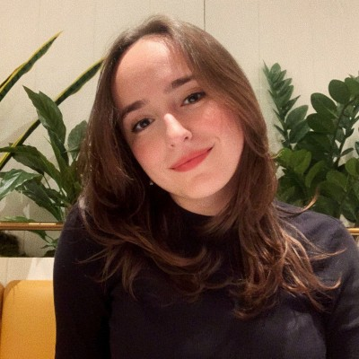
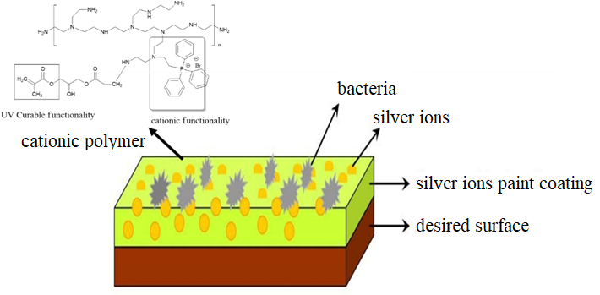
YTU
Faculty of ARTS AND SCIENCE
DEPARTMENT OF CHEMISTRY
PRESENTATION OF SEMINER COURSE
ZEHRA DESTANOĞLU
21572001
Subject
Antimicrobial UV Coating by Using Quaternary Polymers and Metal Nanoparticles
Supervisor
Prof. Dr. Tarık Eren
Date: 10/05/2022 Time: 12.30
Location: Faculty of Arts and Science B2-D10

